Slide 1


@weekstweets

Slide 2
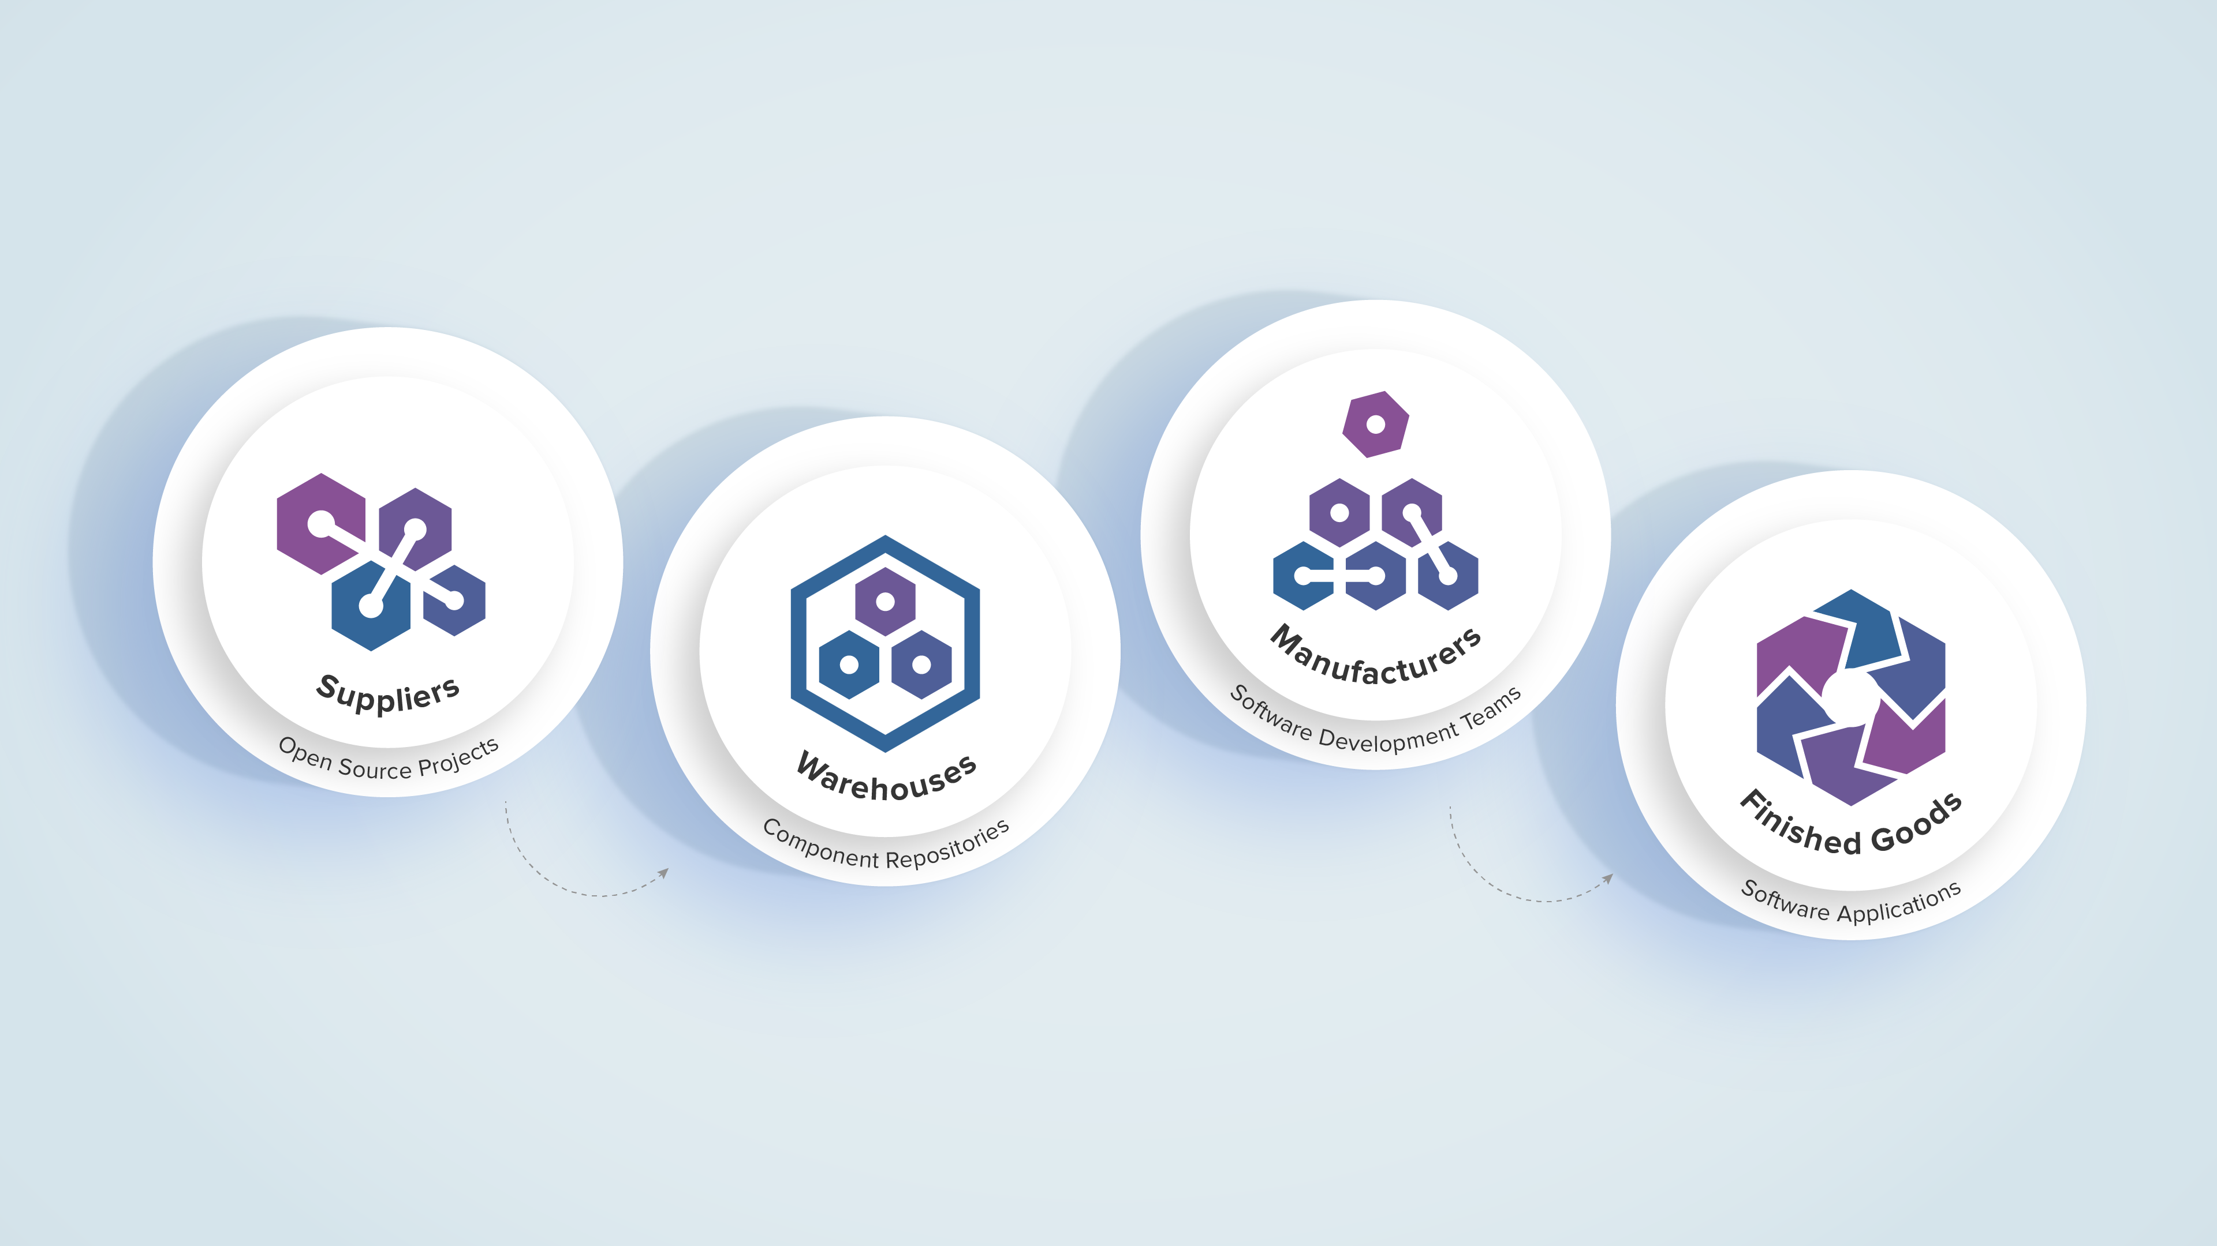
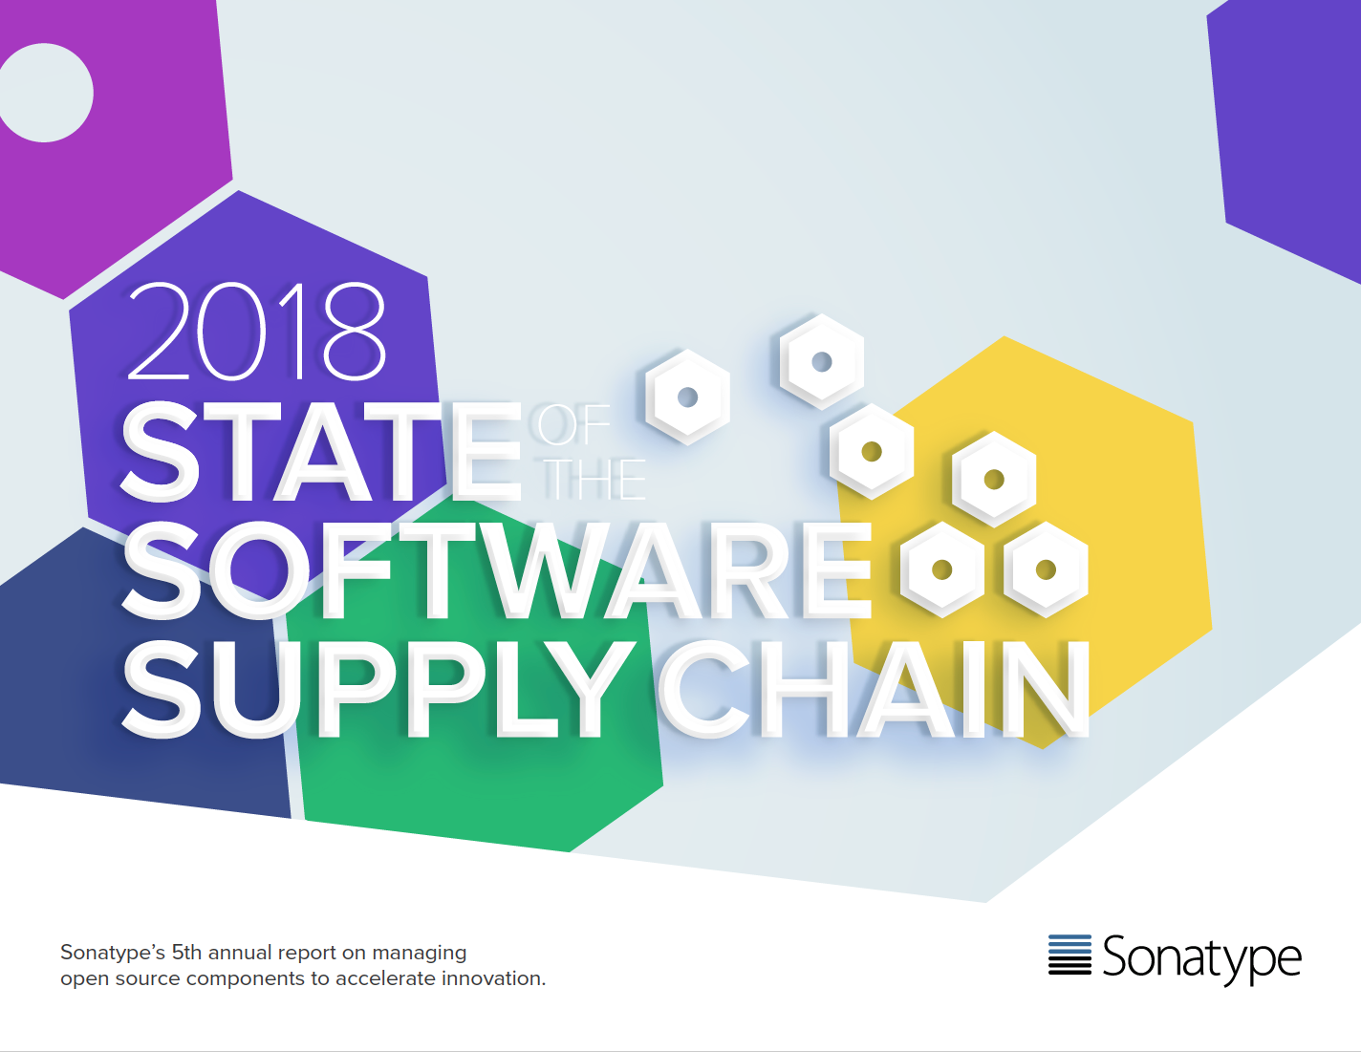
Everyone has a software supply chain.
(even if you don’t call it that)

Slide 3
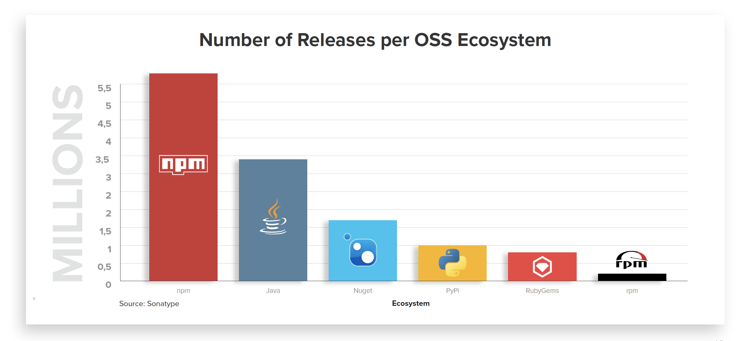
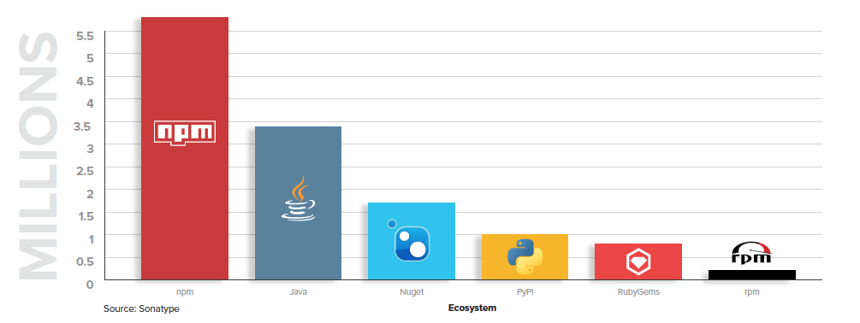
Demand Drives 15,000 New Releases Every Day
Number of Releases Per OSS Ecosystem
@weekstweets
Notes:
There's a really interesting site out there called moduleaccounts.com. It has a simple value, it keeps track of the number of different components, or packages that are available across the different development languages, from pipi, to nuget, to bower, to maven, components, etc. And it shows the increase in the number of these components that are available to the developer ecosystem, or the developer population, over time. We used some data from that site to see that over a thousand new open-source projects were created each day. People delivering a new kind of software, a new kind of component.
Then, from the general population of all open-source projects worldwide, we were able to estimate that ten thousand new versions of components are introduced every day. There's this huge supply of components entering the ecosystem, and available to our software supply chains. When we look at the central repository that Sonatype manages, of maven style or java open-source components, we looked across 380 thousand open-source projects, and found that on average those projects were releasing fourteen new versions of their components every year. That's great from a supply chain aspect, that the suppliers are very active, actively releasing new software, actively releasing new innovations, and actively improving the software that they're making available to developers worldwide.

Slide 4
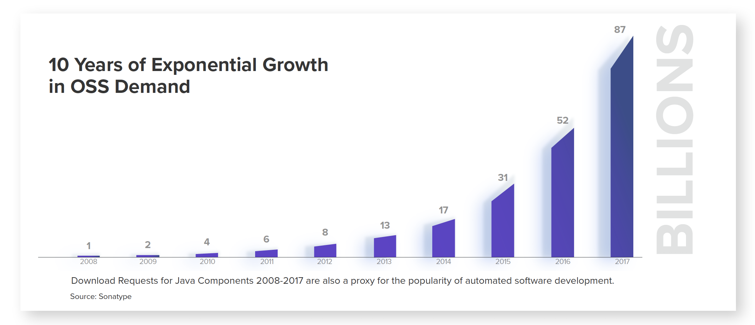
Automation accelerates OSS downloads
Source: Sonatype

Slide 5
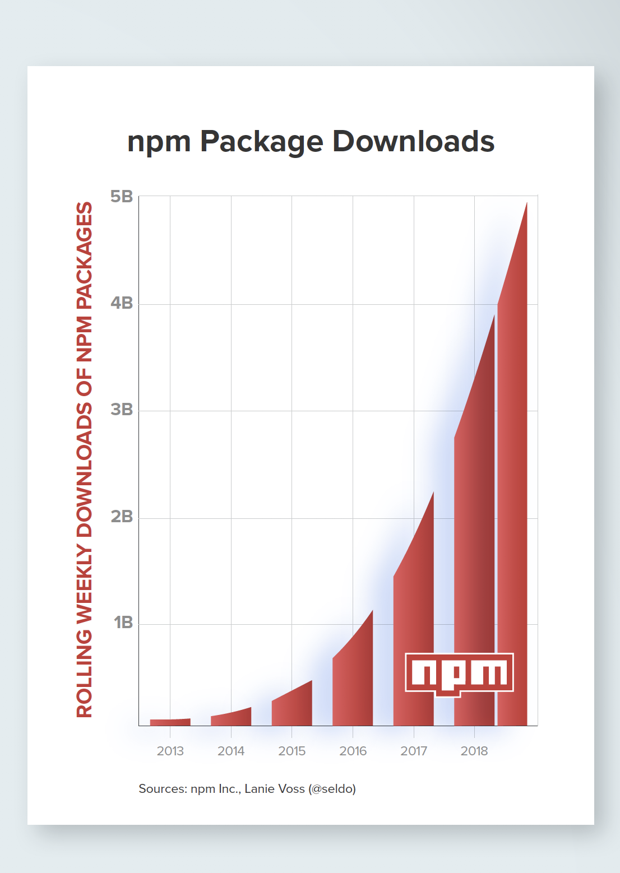
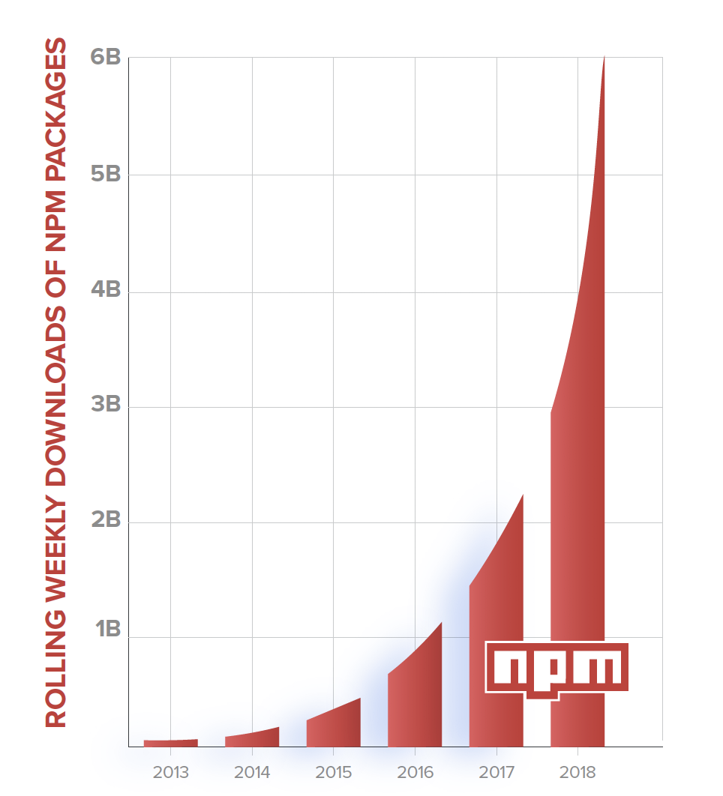
npm package downloads

Slide 6
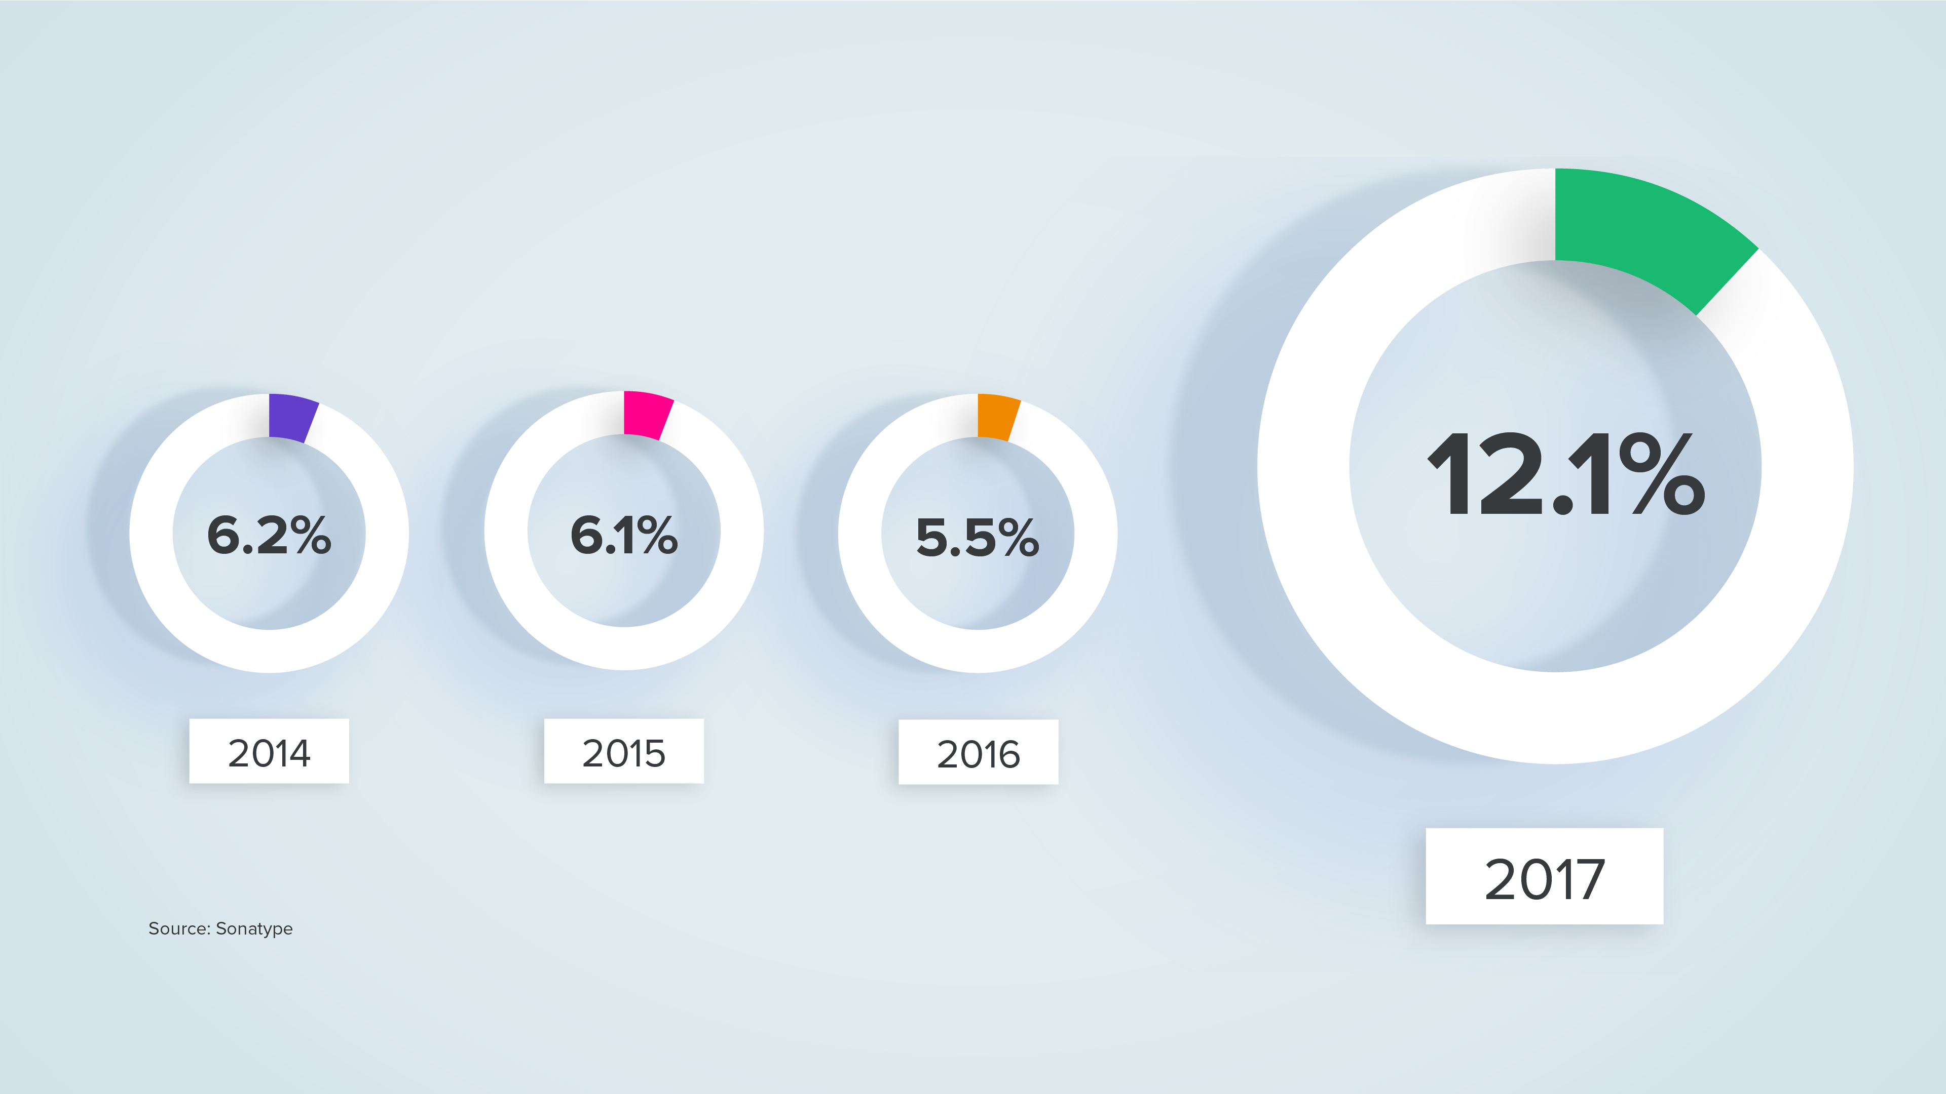
Not all components are created equal

Slide 7
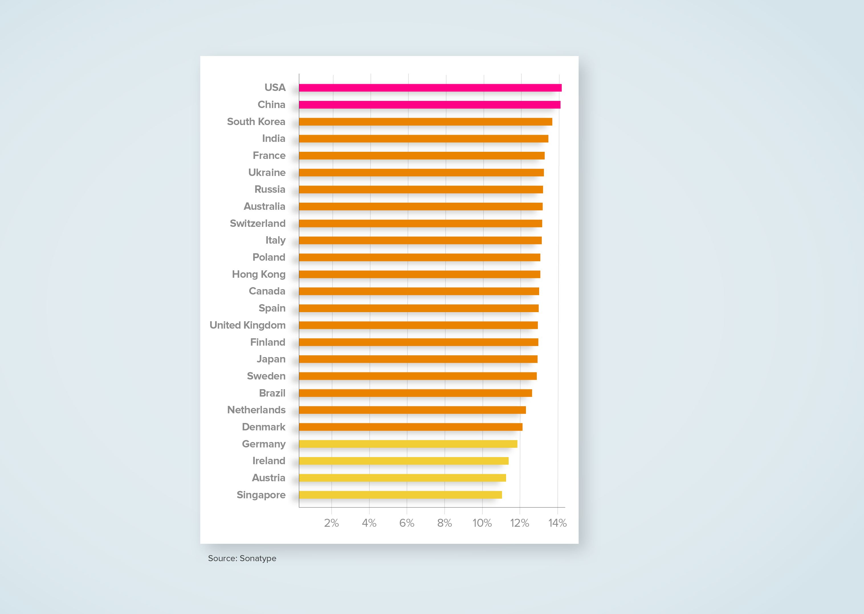
All Countries Show Poor Cyber Hygiene
1 in 7 Downloads
1 in 9 Downloads

Slide 8

7,500 organizations analyzed
170,000
java component downloads annually
3,500
unique
18,870
11.1% with known vulnerabilities
@weekstweets

Slide 9
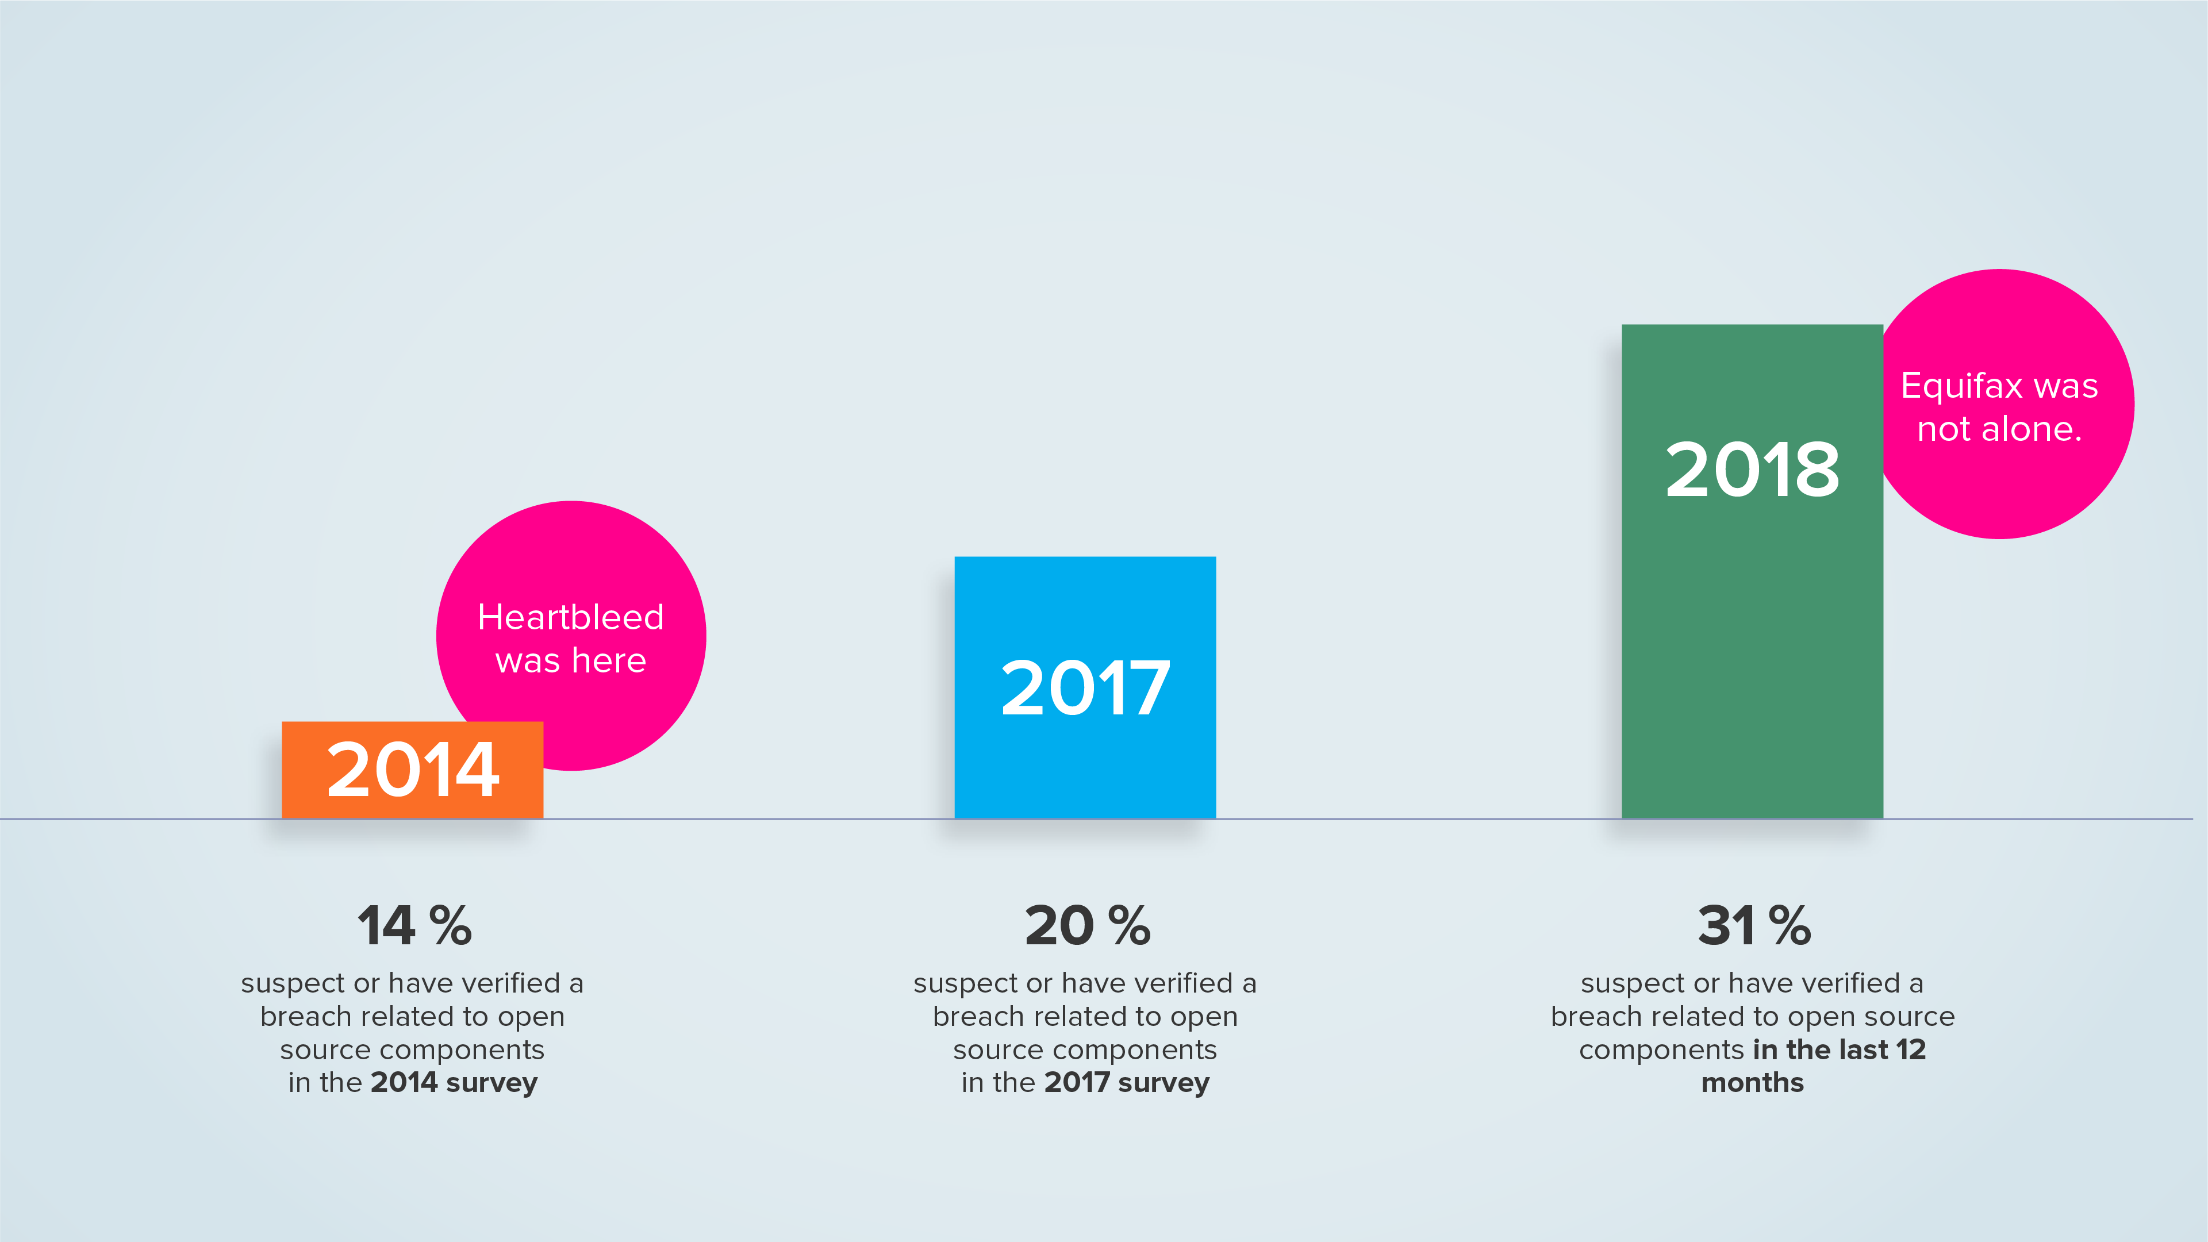
Breaches increased 55% YOY

Slide 10
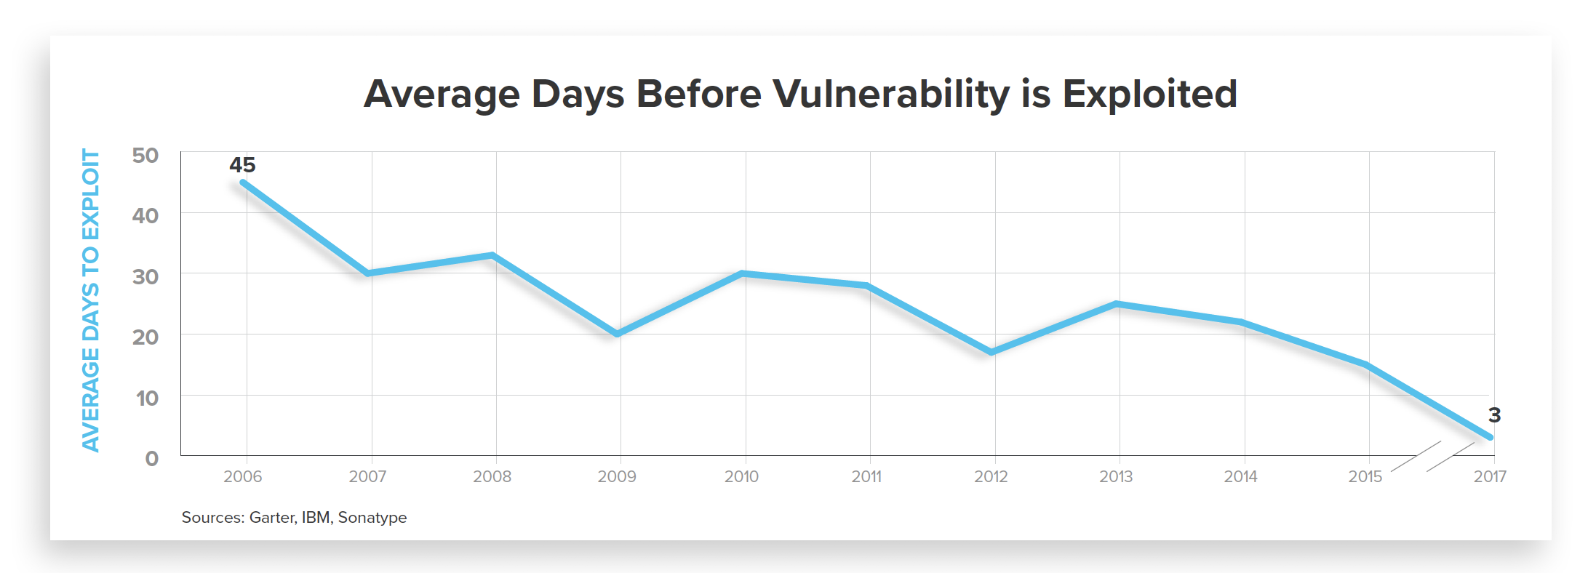
The speed of exploits has compressed 93%
Sources: Gartner, IBM, Sonatype
@weekstweets

Slide 11
Software’s big hack
Equifax was not alone
March 7
Apache Struts releases updated version to thwart vulnerability
CVE-2017-5638
March 9
Cisco observes "a high number of exploitation events."
March 13
Okinawa Power
Japan Post
April 13
India Post
March ’18
India’s AADHAAR
3 Days in March
The Rest of the Story
March 8
NSA reveals Pentagon servers scanned by nation-states for vulnerable Struts instances
Struts exploit published to Exploit-DB.
March 10
Equifax
Canada Revenue Agency
Canada Statistics
GMO Payment Gateway
December ’17
Monero Crypto Mining
Today
8,780 continue to download vulnerable versions of Struts
57% of the Fortune 100
@weekstweets

Slide 12
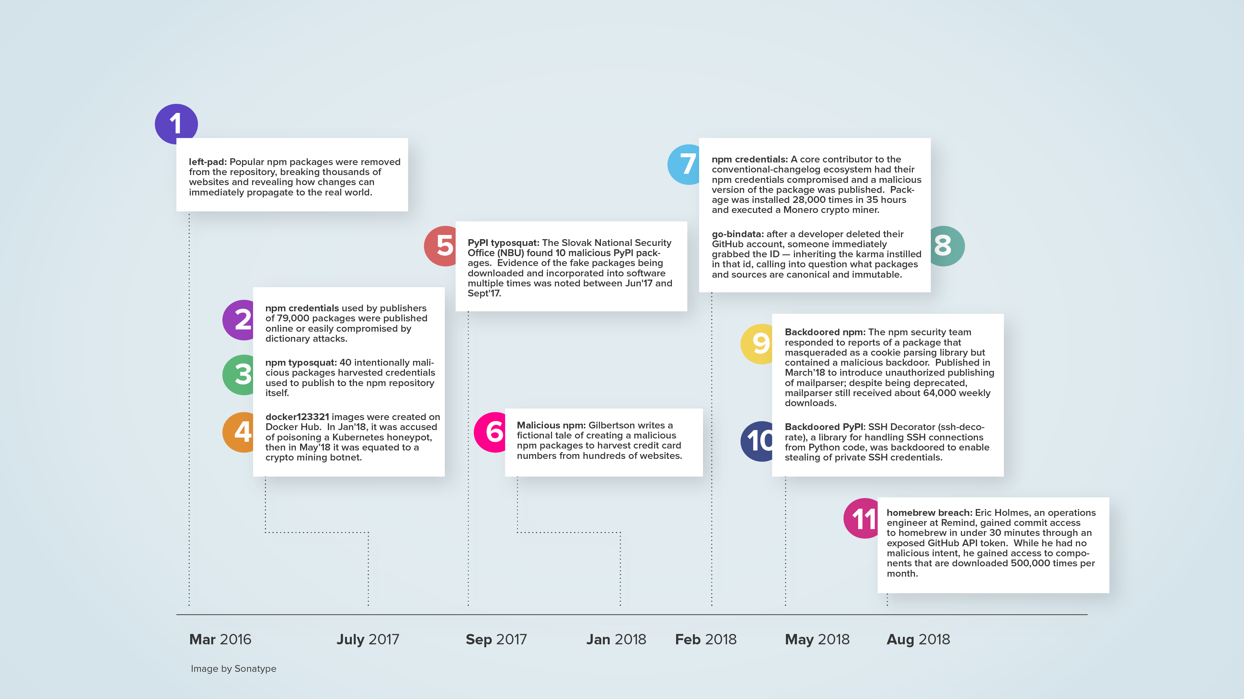
Software’s Big Hack
A shifting battlefront of attacks (March 2016 – August 2018)

Slide 13
DevSecOps challenge: automate faster than evil.
@weekstweets
Notes:
Ever since 2009 when John Aspaw shared Etsy’s practice of 10 deploys a day, the rest of the development industry has been trying to catch up.

Slide 14
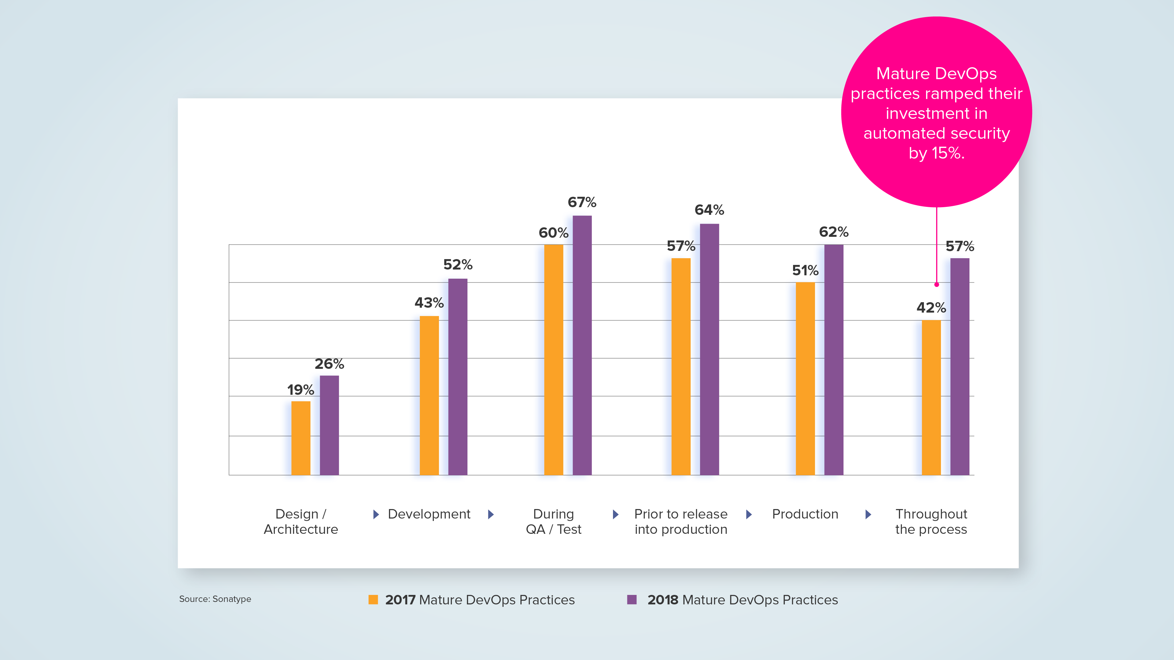
DevSecOps automation helps

Slide 15
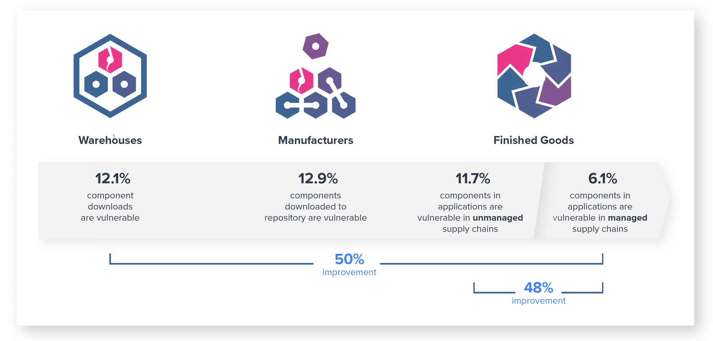
Trusted software supply chains are 2x more secure

Slide 16
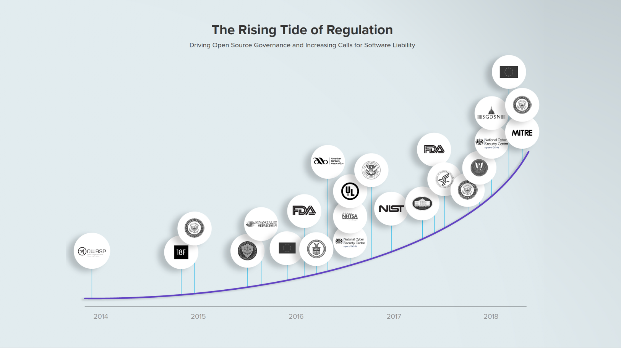
The rising tide of regulation and software liability

Slide 17
Thank you.
Find me on Slack now in #keynotes.
I’ll share my slides there.
@weekstweets

Slide 18
